Slide 1

Google play store app data analysis
Aishwarya SVS (002774851)
Akash Ghanta (002960065
Mohit Chodisetti (002766129)
Mrudula Challagonda (002765266)
Notes:
NOTE: Want a different image on this slide? Select the picture and delete it. Now click the Pictures icon in the placeholder to insert your own image.

Slide 2
Overview
On an average 95,000 mobile apps were released through the Google Play Store, down from the previous month.
Actionable insights and at-a-glance visibility are provided to enable developers to work on and capture the Android market.
The Google Play Store App dataset contains immense possibilities to improve business values and have a positive impact.
Example: We can find the top three categories with the highest number of applications, or we can compare the positive and negative sentiments of each category by accumulating the number of positive and negative sentiments in each application into categories.

Slide 3
Project Objective
Our main aim is to bring out the interconnected hidden links among the different features of the google play store download data.
Our main intended target audience are:
Application investors
App Developers

Slide 4
Methodology
Data Collection
Data Cleaning
Data Transformation
Exploratory Analysis and Visualization

Slide 5
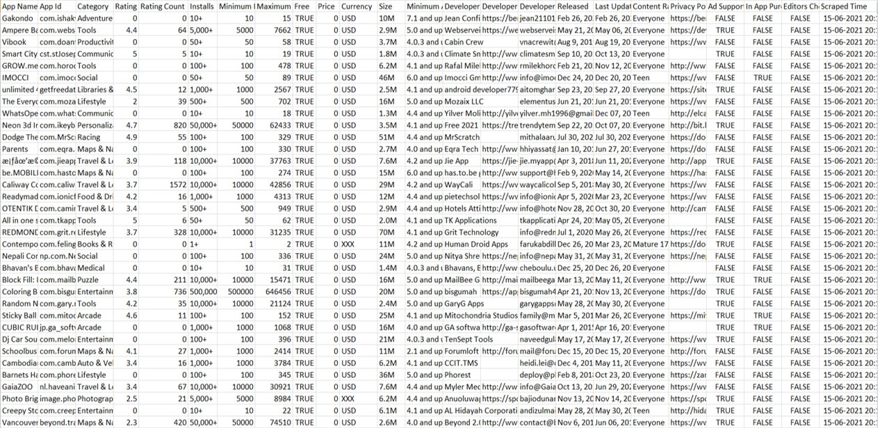
Data Collection
Google Play Store Apps Dataset.
Web scraped data of 50K+ Play Store apps for analyzing the Android market.
Source: Kaggle (Google Play Store App Data).
Contains 24 features (columns) with 2.3 million records

Slide 6
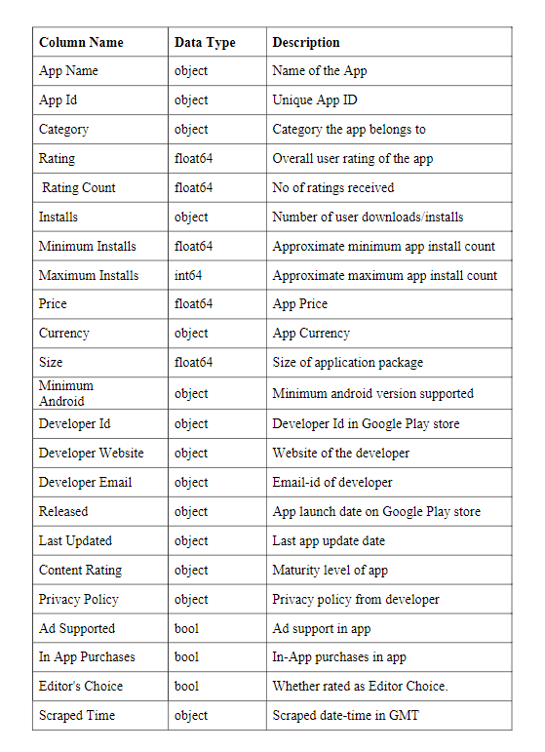
Data Dictionary

Slide 7
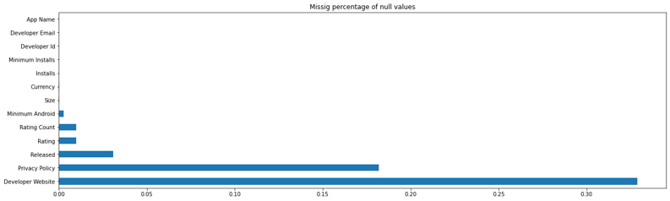
Cleanse and Validate Data
Crucial for removing faulty data and filling in gaps.
Removed null values and checked for duplicates.
Used Gib Score to remove the gibberish names.
We were left with a dataset that had 1.8 million records after cleansing the data.

Slide 8
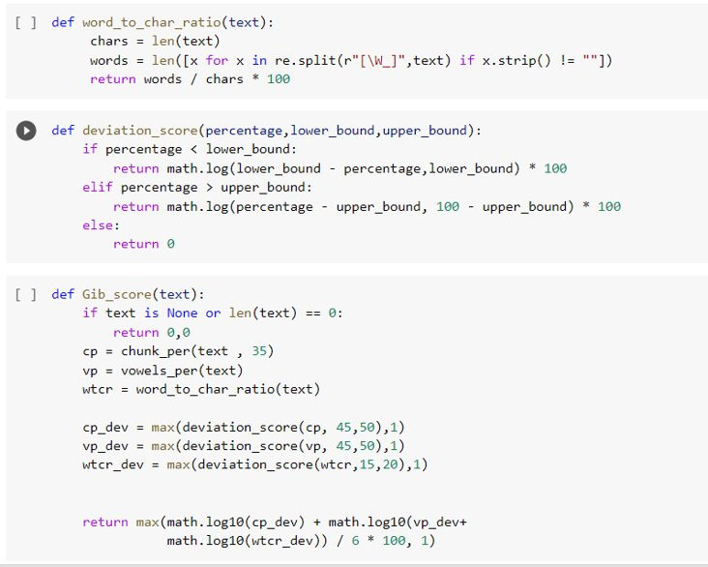
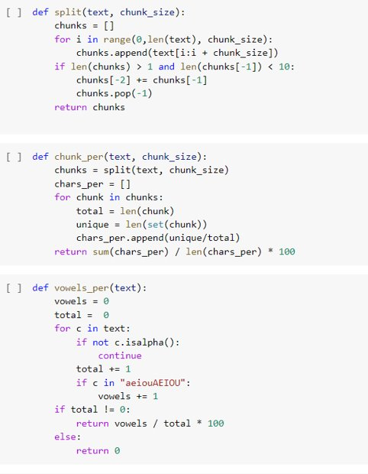
Gibscore to Clean Other Languages Data

Slide 9
Gibscore to Clean Other Languages Data
Using Gibberish Classification algorithm to detect whether text is valid, or randomly generated.
It returns a percentage value where a low one means valid text, and a high one means gibberish text.
We are not considering non-English apps in our case.

Slide 10
Data Transformation
Transforming data is the process of updating the format or value entries to reach a well-defined outcome, or to make the data more easily understood by a wider audience.
Converted few of the continuous features to categorical data for better analysis.
Restricted "Content Rating" column which had 6 different age groups to just 3 categories of “Everyone”, “Teen” and “Adults”.
The 'rating' column has too many unique values since they are decimals. So, we added a new column and categorized the ratings into 5 bins.

Slide 11
Exploratory Analysis and Visualization
Data visualization is the process of describing information through visual rendering.
Technological advances have made data visualization more prevalent and powerful than ever before.
We have used Tableau for exploratory analysis and visualization.
Tableau is ground-breaking visualization software which connects easily to nearly any data source. It allows for instantaneous insights by transforming data into interactive visualizations called dashboards.

Slide 12
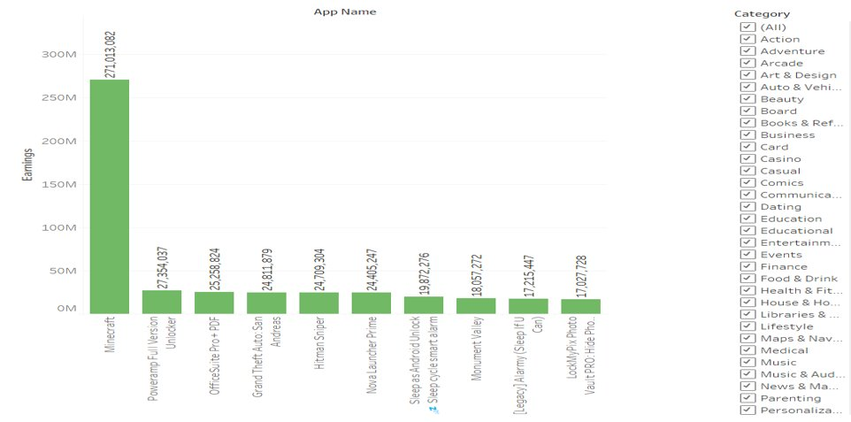

Slide 13
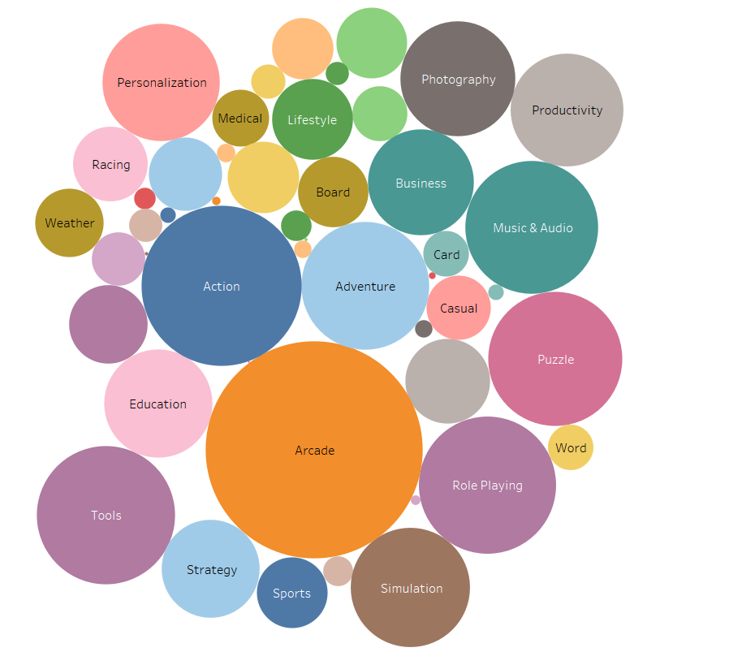

Slide 14
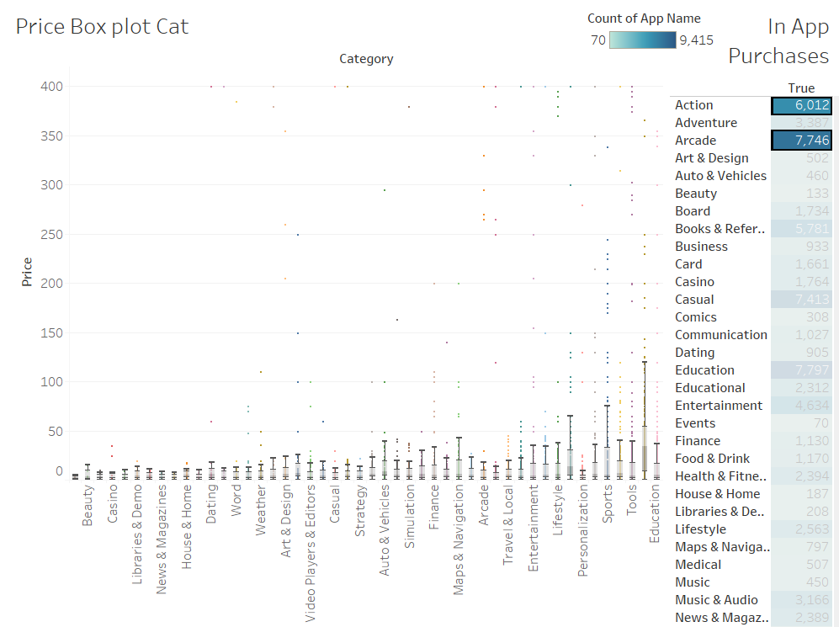

Slide 15
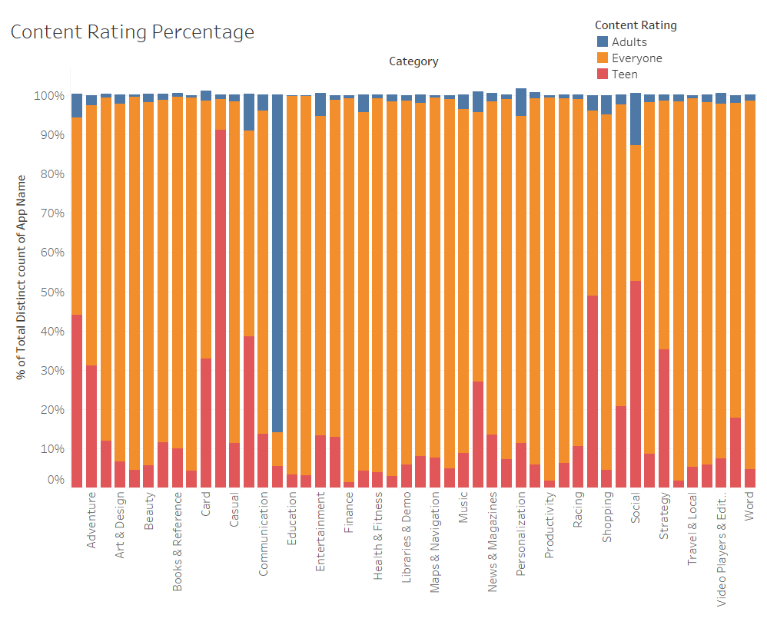

Slide 16
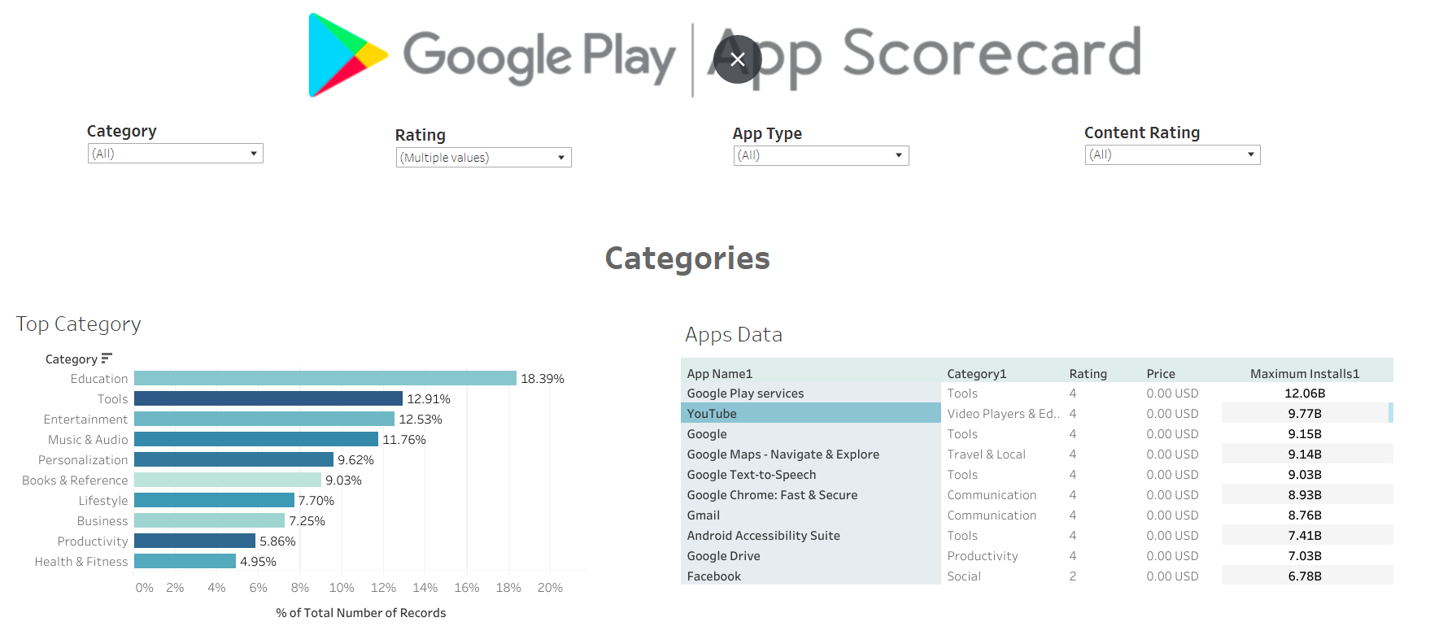

Slide 17
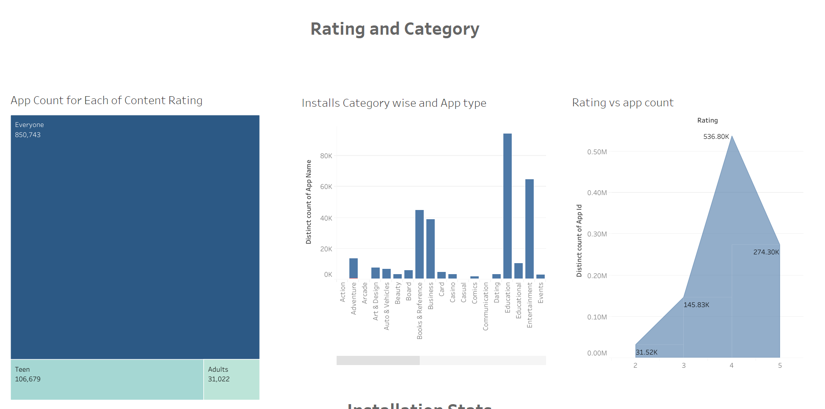

Slide 18
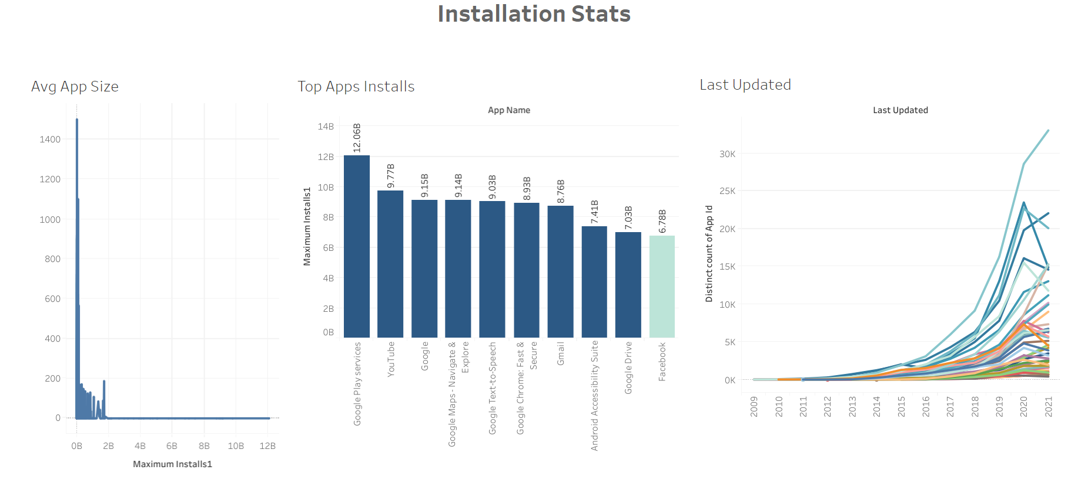

Slide 19
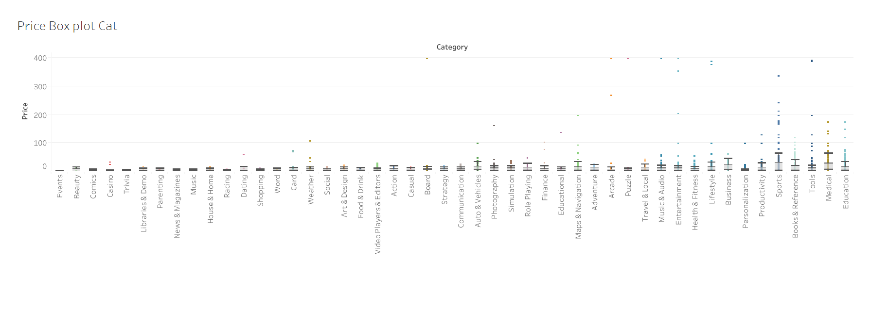

Slide 20
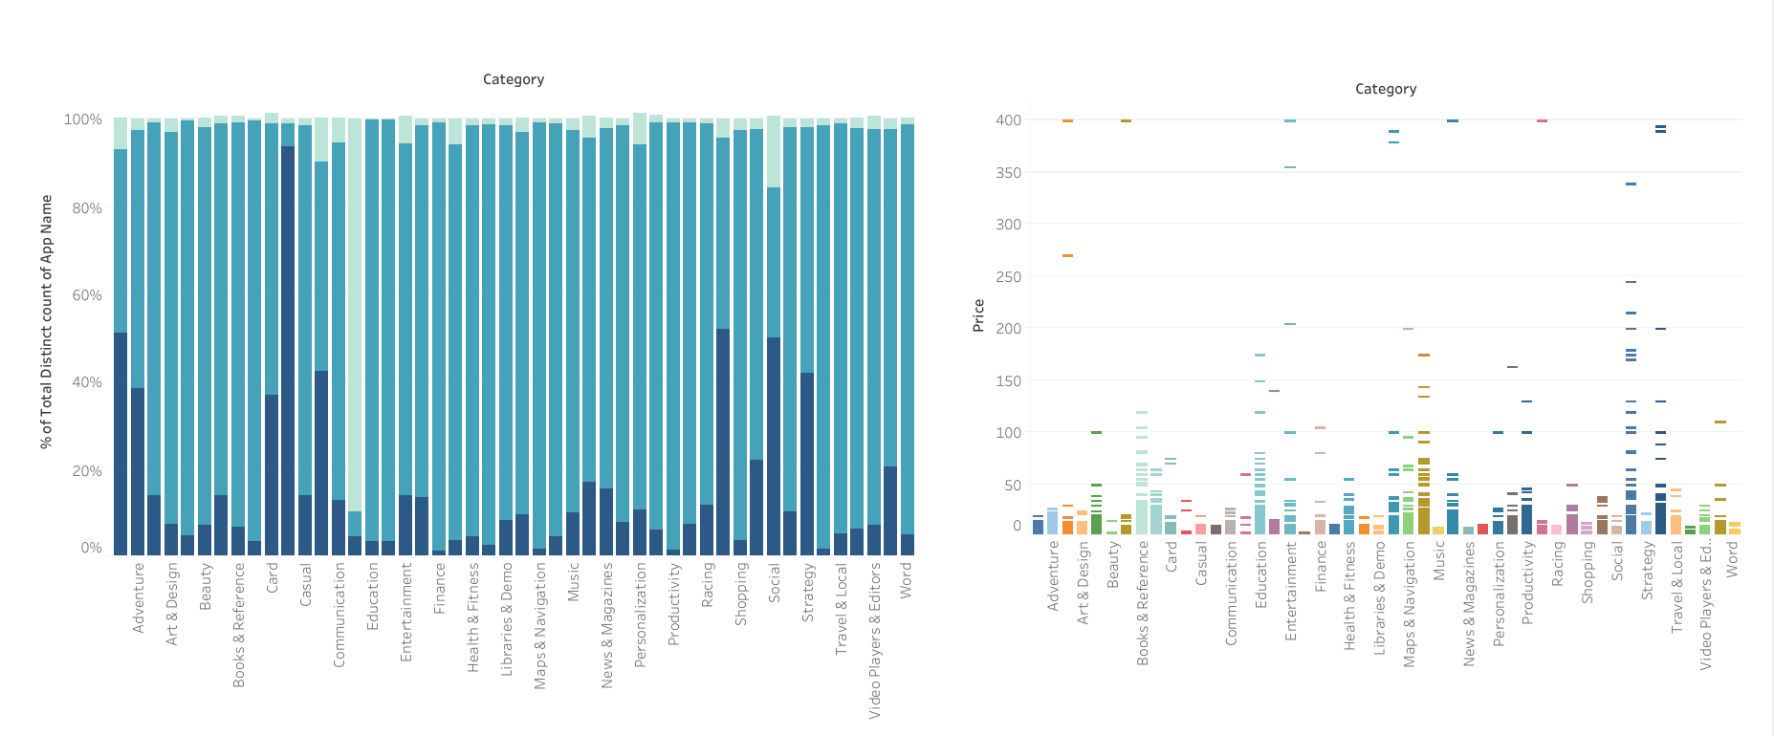

Slide 21
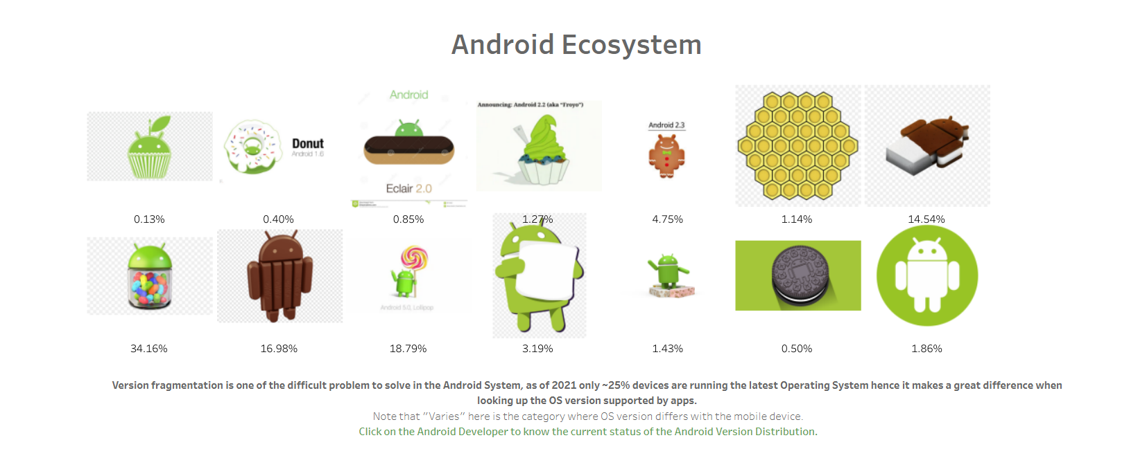

Slide 22
Conclusions
After analyzing the dataset, we have got answers to some of the serious & interesting questions which any of the android users would love to know:
Top categories on Google Play store?
What percentage of apps are Free and Paid?
Which category of apps has the greatest number of installs?
What are the Top 10 installed apps in different categories?
Which are the top expensive Apps?

Slide 23
Conclusions
There are a total of 48 categories and the highest amount of application base on categories is Education, followed by Tools and Entertainment and least are of Parenting and Comics Category.
Based on 'Content Rating', Everyone category has the highest number of apps.
There are approximately 2% Paid Apps and 98% Free Apps.
The top five apps with the highest earnings found on google play store are:
Minecraft
Poweramp
OffieSuite
GTA San Andreas
Hitman Sniper

Slide 24
Future Work
Merge more datasets together and get a column for “Region”. This would be an important factor when it comes to performing country level analysis. A couple of apps are available only in select countries.
We also plan on obtaining a time series dataset, i.e., with an added Date column. With this information we can provide analysis on the shift in the usage of Apps over time.

Slide 25
Thank You!

